Slide 1
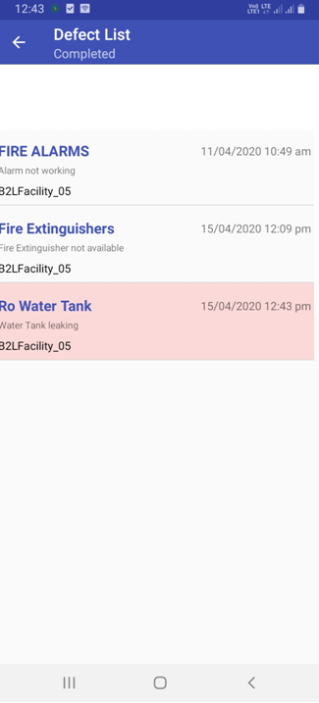
Bill Not Approval
Bill Approval

Slide 2
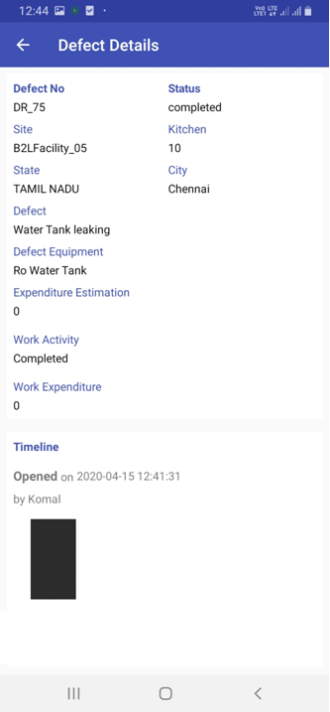
If click this button Confirmation Alert should come
“It seem MST to Resubmit the Bill”
It’s goes to MST Panel and MST have provision to capture the Bill copy again.
Bill Resubmit
Bill Approval

Slide 3
Select Bearer Type
Merchant
Zomato
CH Expense
Submit
Once select the Bill then its goes to Bill Approval TAB.
Bill Resubmit
Bill Approval

